Slide 1

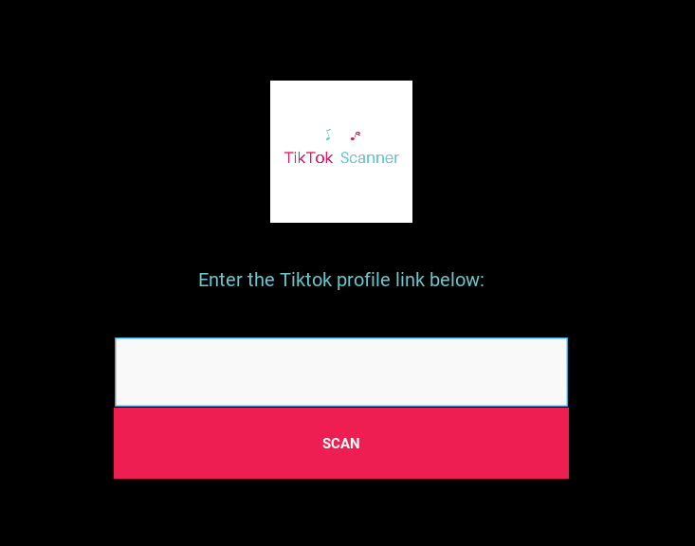
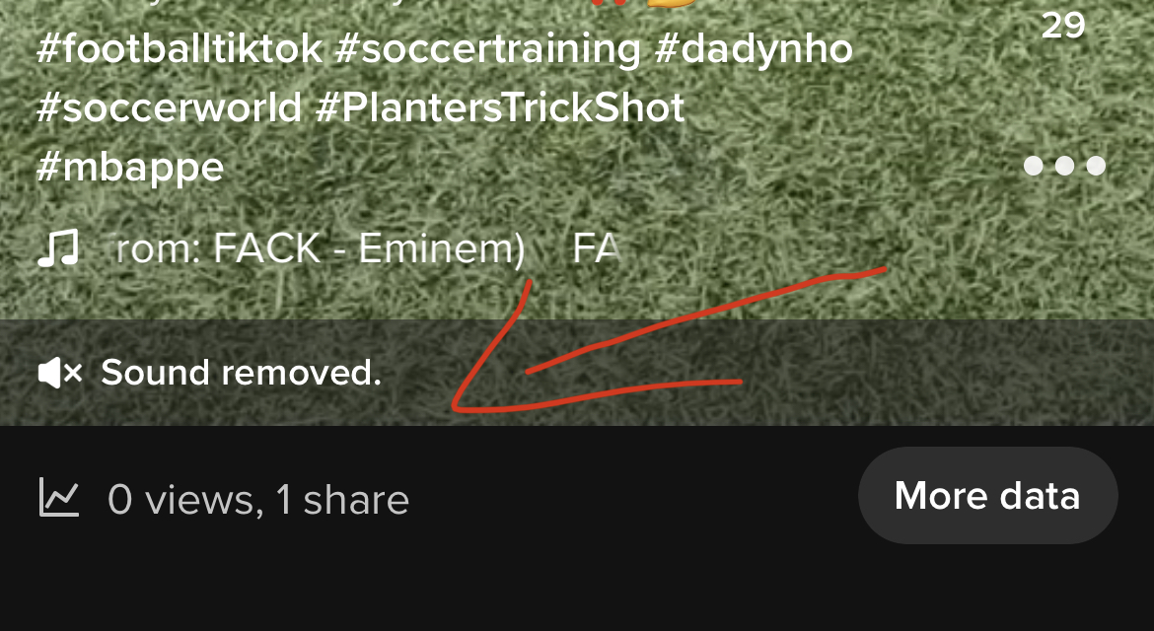
Application that scans a TikTok profile to find videos on which the sound has been removed/muted by TikTok
TikTok Scanner
Team Members: Marc Bineau

